Slide 1
Project:-
Crime
File
Management
Submitted By :-

Slide 2
COMPANY PROFILE
Excellence Technology is an ISO certified company. It has been working from more than 5 years in the field of IT and Web Development and has been providing its clients with its exceptional and quality Web Design, Development and SEO services. Our clients range from individuals to professionals and small, medium and large scaled Businesses. In 2008, Excellence Technology entered into IT outsourcing and partnered successfully with many offshore web and SEO companies of US, UK, France, Ireland, Canada, and Australia etc. to provide them quality and timely services.

Slide 3
During Training We have Study About
Introduction of HTML.
DHTML
CSS
JAVASCRIPT
PHP
ADVANCE PHP
JOOMLA
AJAX
WORDPRESS

Slide 4
What is HTML?
Hyper text mark-up language
Its used for designing purpose
Multiple tags are used
It is also called ‘Client side Scripting Language’

Slide 5
Syntax/ Example
  <html>
  <head>
  <title>bbb</title>
  <body>
  Hello
  </body>
  </head>
  </html>

Slide 6
HTML Tags
</br>
<background>
<bgcolor>
<font>
<marquee>
<img src=“file path”/>
<p>
<pre>
<sub>
<sup>

Slide 7
What is DHTML/CSS
Dynamic hypertext markup language
CSS stands for ‘Cascading Style Sheets’
CSS is two types:-
Internal CSS
External CSS

Slide 8
Syntax of Internal CSS
  <body>
  <p>
  Hello
  </p>
  <p>
  How r u?
  </p>
  </body>
  </head>
  </html>
  <html>
  <head>
  <style>
  P
  {
  color:”color name”;
  Font size:36px;
  }
  </style>

Slide 9
Syntax of External CSS
  <html>
  <head>
  <link href=“s.css”
  Type=“text/css”
  Rel=“stylesheet”
  />
  <body>
  </head>
  <h2>hello
  </h2>
  <body>
  </html>
    s.css
  Body
  {
  Background:red;
  }
  H2
  {
  Color:green;
  }

Slide 10
Javascript
Javascript is user for validation purpose
It is also called scripting language.
Syntax
<script language =“javascript”>
Function abc()
{
alert(“hello”);
}
</script>

Slide 11
What is PHP?
PHP == ‘Hypertext Preprocessor’
Open-source, server-side scripting language
Used to generate dynamic web-pages
PHP scripts reside between reserved PHP tags
  This allows the programmer to embed PHP scripts within HTML pages

Slide 12
About the Project
Website on “Online Crime File Management”
This website provides facility for reporting online crimes, Complaints, missing persons, show most wanted person. Any Number of clients can connect to the server. Each user first makes their login to sever to show their availability.
Visitors
Registered Users
Administrator

Slide 13

Project homepage

Slide 14
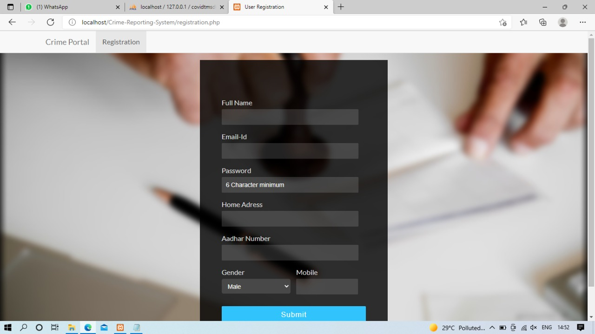
Registration

Slide 15
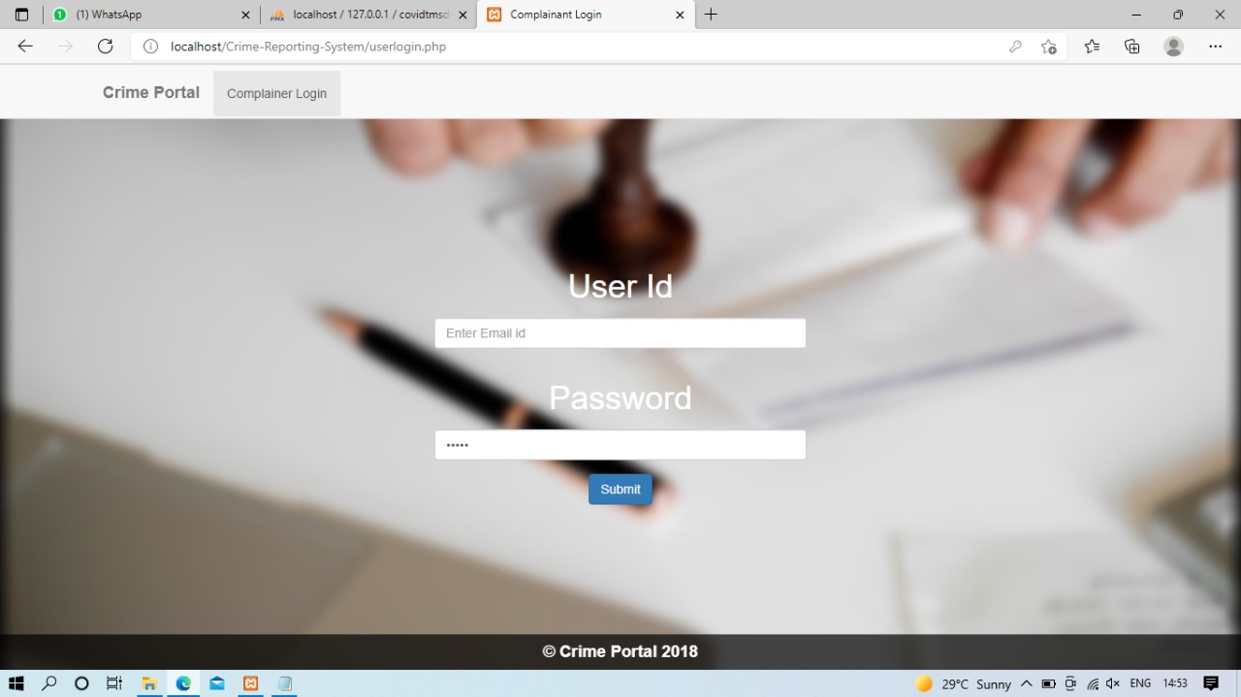
Complainer Login

Slide 16
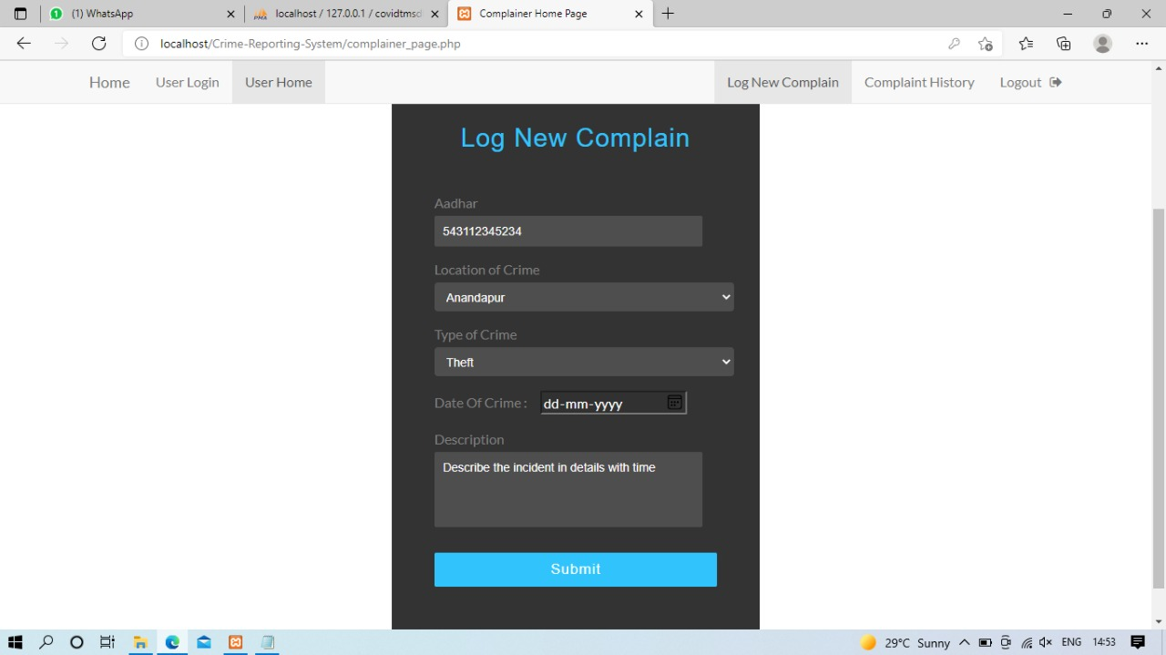
User Login

Slide 17
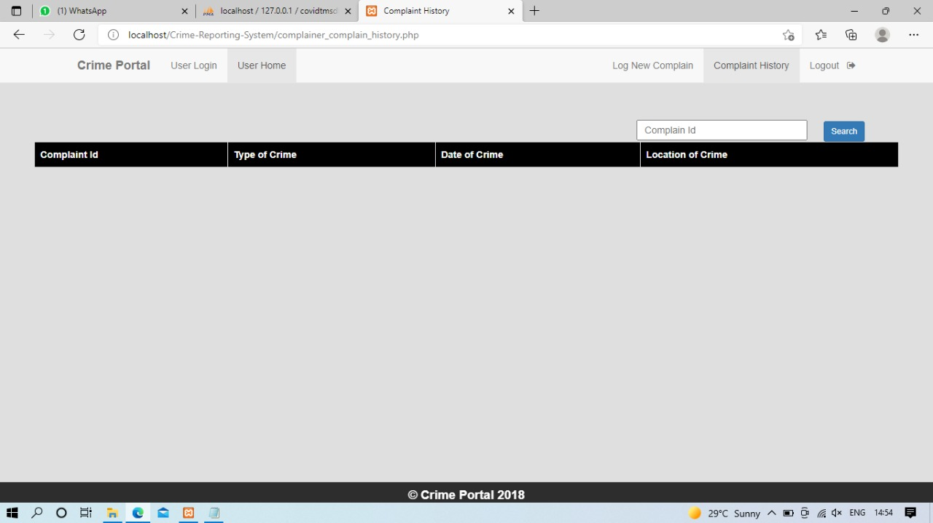

Slide 18
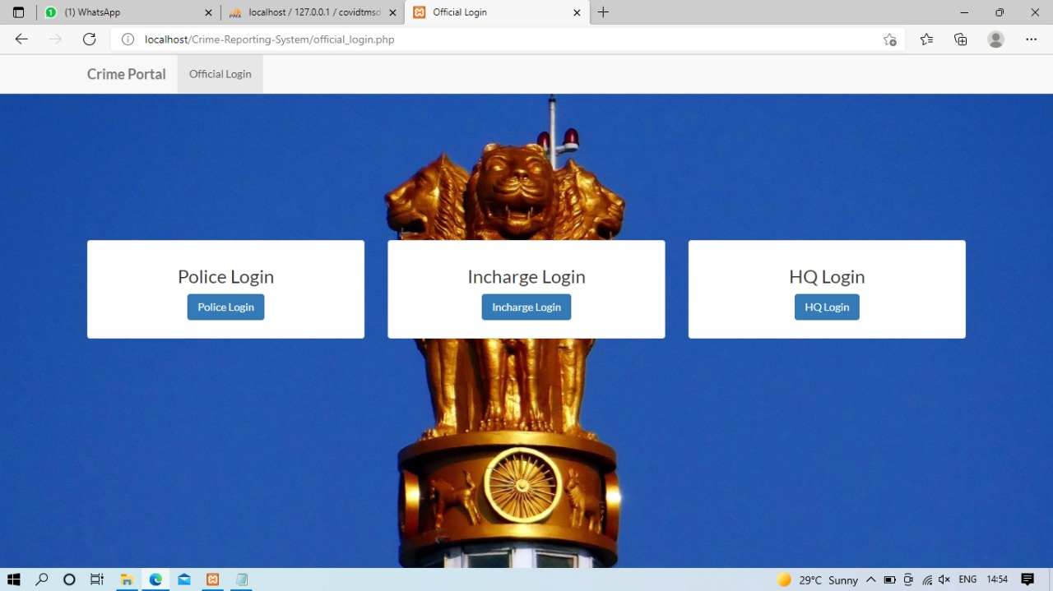

Slide 19
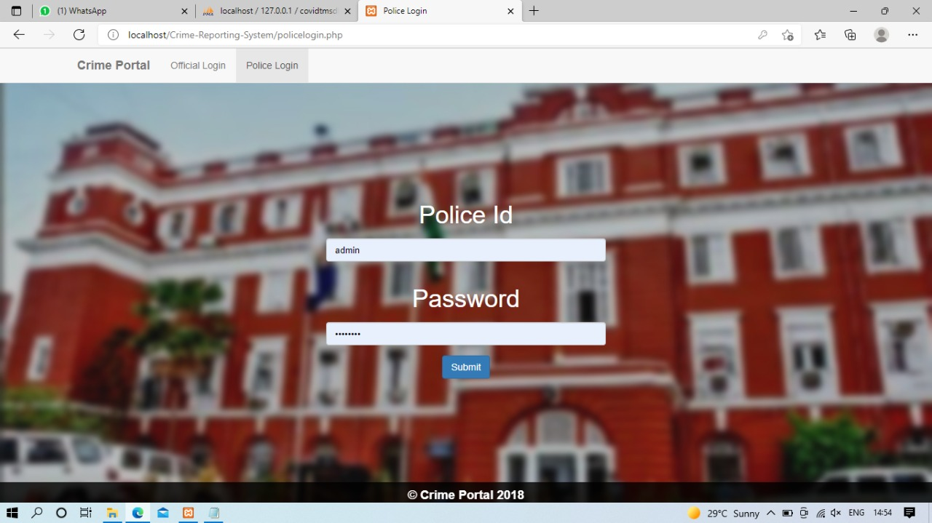
Police Login

Slide 20
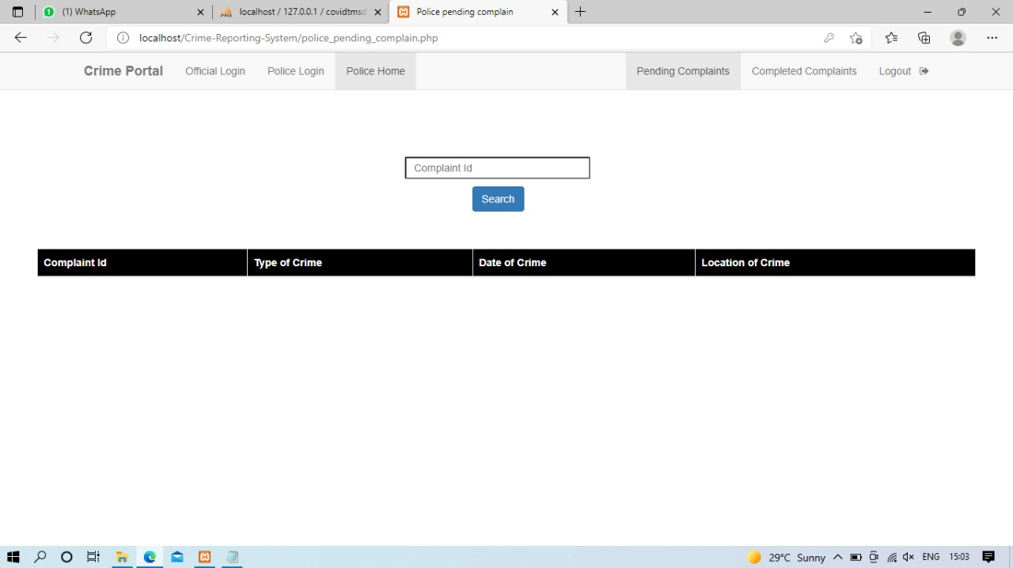
Police Home Page

Slide 21
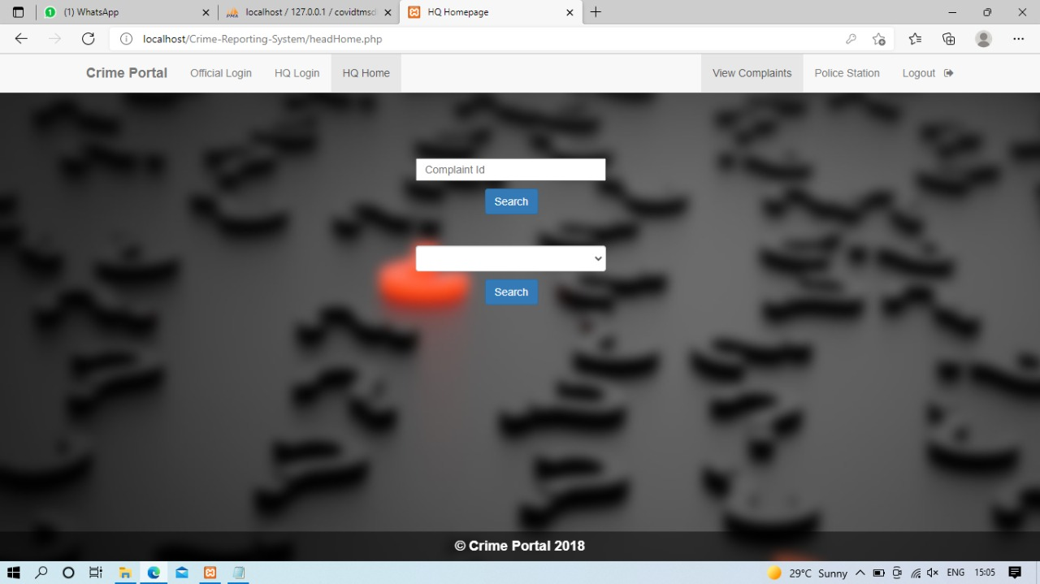
HQ Home Page

Slide 22
THANK YOU

